Slide 1
JCM OSCE Questions
Caritas Medical Centre
3 June, 2015

Slide 2
Question 1
A 30-year-old man presented to the AED with acute onset of bilateral lower limb weakness. He also complained of recent weight loss of 10 lbs in 2 months. Physical examination found marked decreased in proximal muscle power, with decreased deep tendon reflexes. His vital signs: BP 110/54mmHg, P 110/min; An ECG was performed.

Slide 3
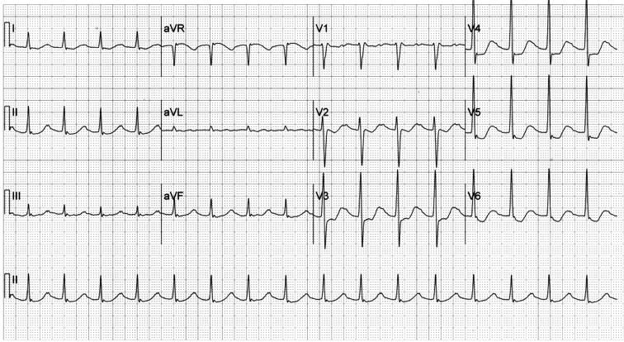

Slide 4
Question 1
1a. Describe the ECG finding.
1b. What is your diagnosis?
1c. Name 3 important steps in managing this patient
1d. Name 3 precipitating factors for this condition
1e. Suggest 1 prophylactic medication to prevent this condition from happening

Slide 5
Question 2
A 45-year-old man chronic drinker was sent by ambulance to ED for confusion and vomiting. He was unable to take food for 3 days. Blood results as follows:

Slide 6
Blood results
WCC 11.6 x 10^9/L
Hb 15.7 g/dL
MCV 105.2 fL
Na 140 mmol/L
K 3.8 mmol/L
Cr 150 mmol/L
AST 414 u/L
ALT 198 u/L
Bilirubin 44mol/L

Slide 7
2a. Explain the likely cause of the abnormalities in patient’s blood tests
2b. Give 4 physical signs on examination of hands that are suggestive of chronic liver disease
2c. Give 3 features of acute delirium tremens
2d. Outline the ER management

Slide 8
Question 3
A 35 year-old-man, with good past health, attempted suicide by taking a pack of mothballs two days ago. He was sent by ambulance to AED with a complaint of increasing generalised weakness. On arrival, he had stable vital signs and was fully conscious. Urine sample was saved.

Slide 9
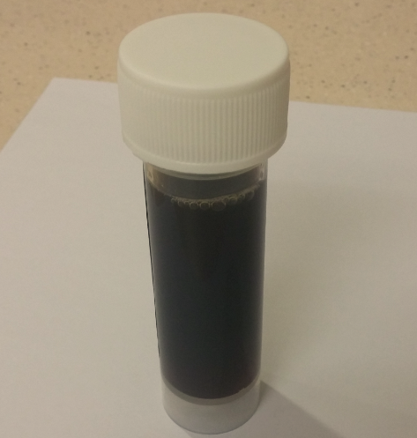
Urine sample

Slide 10
Question 3
3a. What do mothballs contain?
3b. What does the urine sample signify?
3c. Which kind of mothball had the patient taken?
3d. How do you distinguish different mothballs clinically?
3e. What are the potential complications of this patient?

Slide 11
Question 4
An 18 year old boy presents to the ED one day after injuring his right ankle while skateboarding. He was attempting to jump and landed with a twisted ankle. He cannot bear weight. His ankle was swollen. X ray was taken

Slide 12
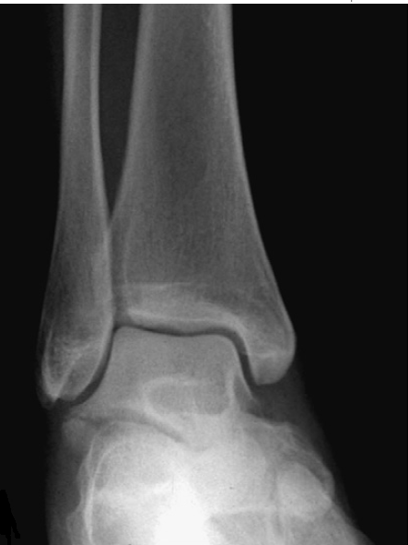

Slide 13
Question 4
4a. What is the X-ray finding?
4b. What is the mechanism of injury?
4c. How do you treat this type of injury?

Slide 14
Question 5
A 20 year-old man attended AED after suffering a squash ball injury to his left eye. His vision is 20/20 bilaterally. He has no tenderness over his facial bones. He has normal and painless extra-ocular movements. He denies any diplopia.

Slide 15
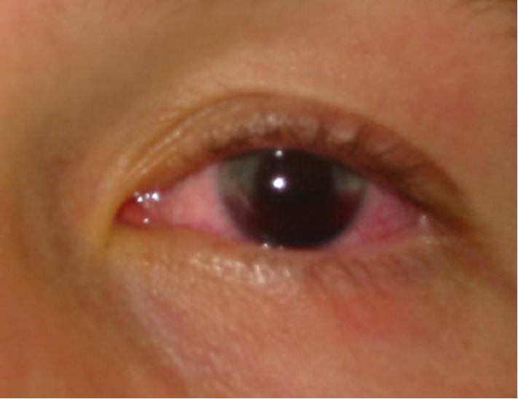

Slide 16
Question 5
5a. What is the diagnosis ?
5b. Name three causes of this condition
5c. Describe the grading system of this condition
5d. What treatments are recommended for this patient?
5e. Name 3 potential complications

Slide 17
Question 6
An five-year-old boy is brought by his parents to the AED, complaining of severe abdominal cramps, recurrent vomiting, joint pain and lower limb rash for 1 day. Parents recall that the patient had a febrile illness with dry cough and running nose a week ago
Temp 38.7C, heart rate 128/min, RR 24/min

Slide 18
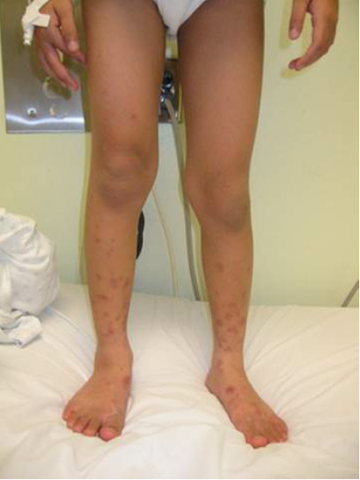
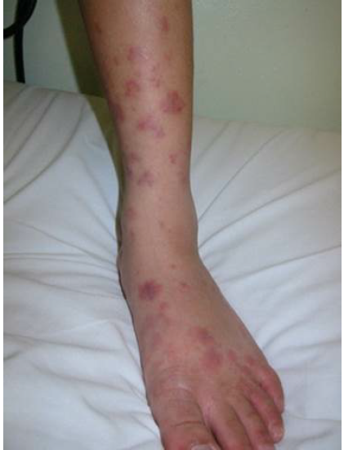

Slide 19
Question 6
6a. What is your diagnosis ? Name 3 other important diagnoses that need to rule out.
6b. What is the primary cause of this condition?
6c. Name 3 investigations.
6d. What is the treatment?
6e. Name 4 complications.

Slide 20
END

